Slide 1
Accurate Cooperative Sensor Fusion by Parameterized Covariance Generation for Sensing and Localization Pipelines in CAVs
Edward Andert and Aviral Shrivastava, ITSC 2022

Slide 2
Agenda
Motivation
Related Work
Experimental Setup
Our Approach
Results
Summary

Slide 3
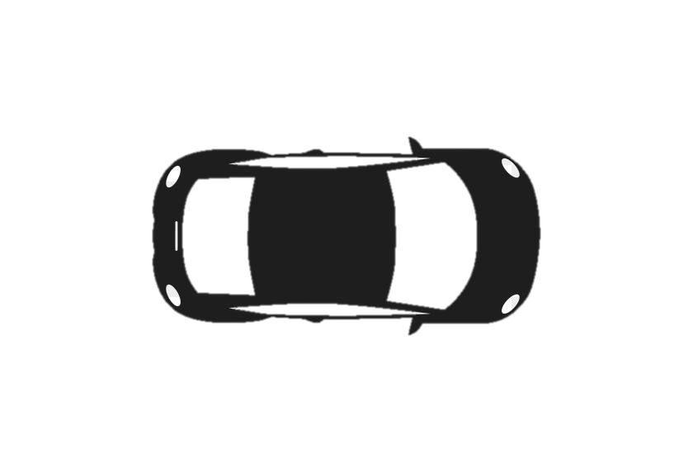

Motivation
Consider this cooperative sensor fusion scenario:
Two connected autonomous vehicles (CAVs) w/ an identical sensor suit are equidistant from a person
Sensor fusion is easy, weight them the same
5 meters
5 meters

Slide 4
Motivation
Consider another cooperative sensor fusion scenario:
Two CAVs w/ an identical sensor suit are NOT equidistant from a person
Conventional thinking would assume that the LEFT car should be weighted more
100 meters
5 meters
Left AV Image
Right AV Image

Slide 5
Motivation
Consider a final cooperative sensor fusion scenario:
Two CAVs w/ an identical sensor suit are equidistant from a person
Left CAV is traveling 5x as fast as the right CAV and localization accuracy goes down linearly with velocity
Conventional thinking would assume that the RIGHT car should be weighted more
Position: 33.407489 ± .0001, -111.933636 ± .0001
5 meters
5 meters
Position: 33.407429 ± .0005, -111.933650 ± .0005

Slide 6
Motivation
What if we combined these cooperative fusion scenarios?
These effects must be modeled for cooperative sensor fusion to be accurate
Position: 33.407489 ± .0001, -111.933636 ± .0001
100 meters
5 meters
Position: 33.407429 ± .0005, -111.933650 ± .0005
Left AV Image
Right AV Image

Slide 7
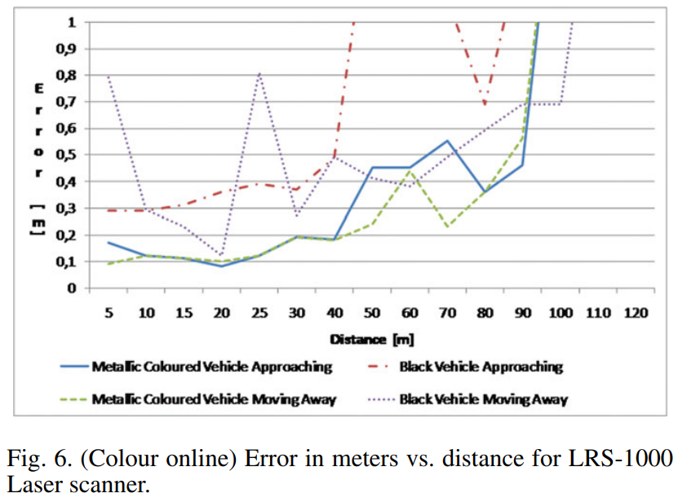
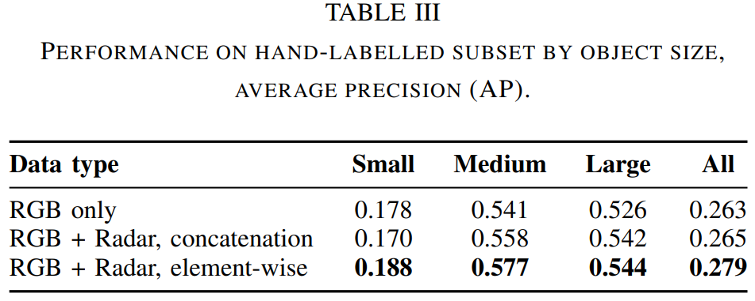
Related Work
Previous works on cooperative sensing in CAVs typically consider error to be static
E.G. mean variance is used
Many works show that there is a relationship with sensing variance and distance
Prior works do not add in the effect of localization variance into the sensor fusion
Localization error must be added to sensor error when converting to a global coordinate system
Source: García, Fernando, et al. "Environment perception based on LIDAR sensors for real road applications." Robotica 30.2 (2012): 185-193.
Source: Chadwick, Simon, Will Maddern, and Paul Newman. "Distant vehicle detection using radar and vision." 2019 International Conference on Robotics and Automation (ICRA). IEEE, 2019.

Slide 8
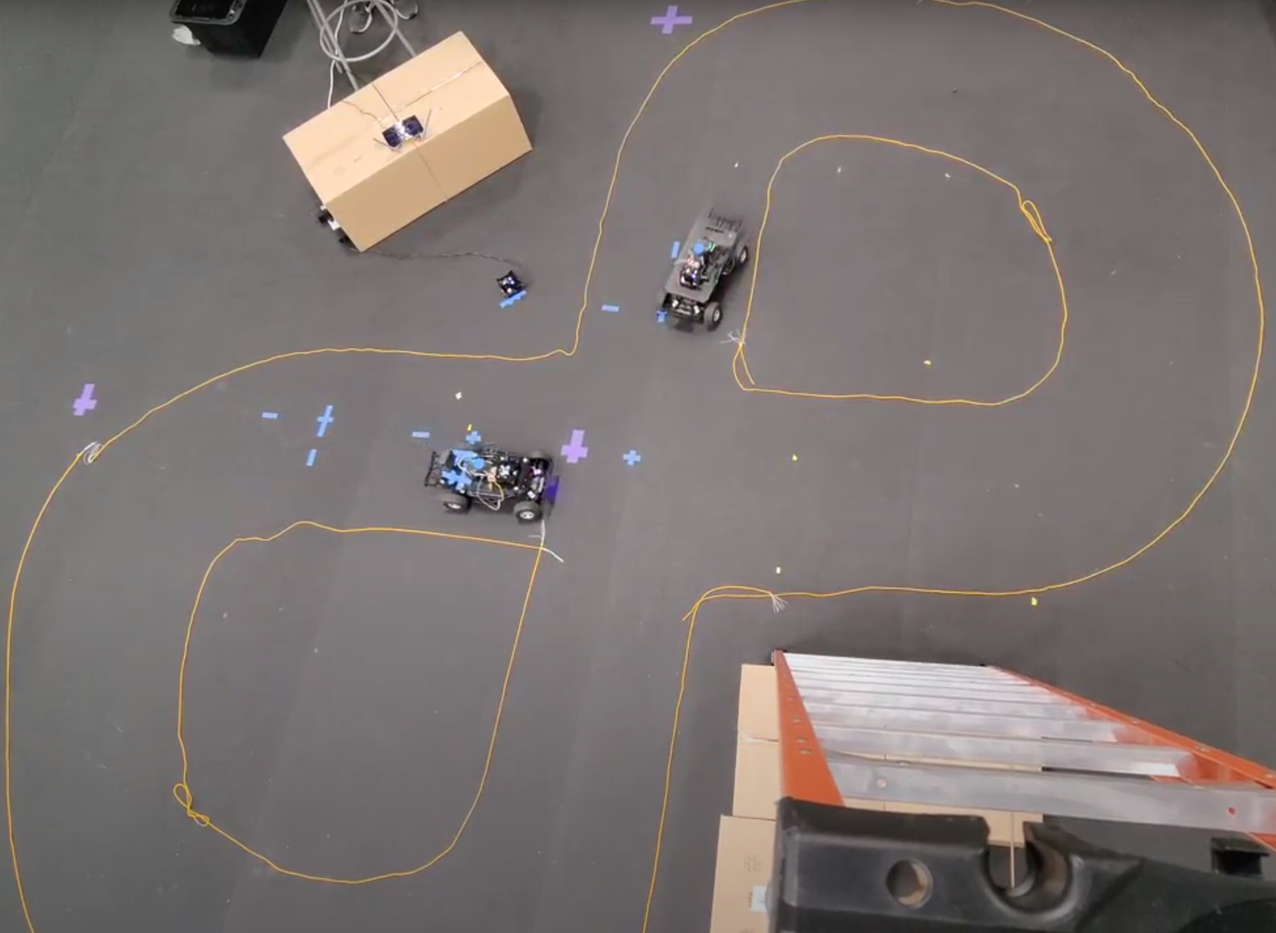
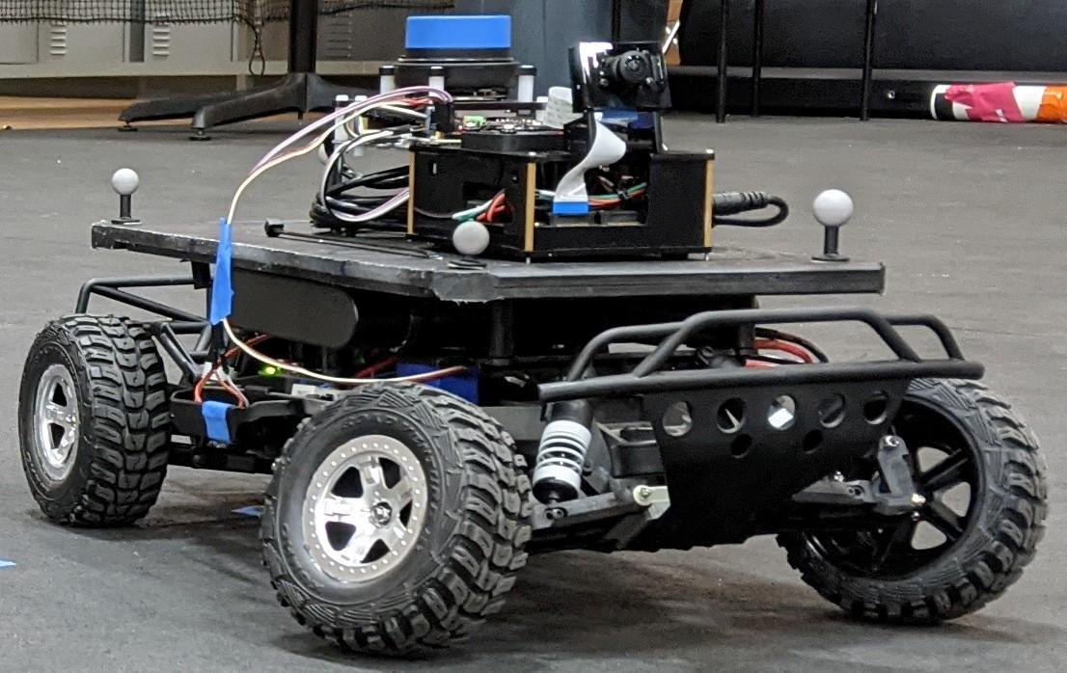
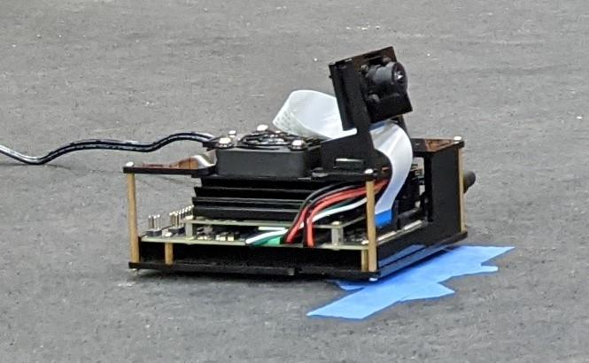
Experimental Setup
We utilize four 1/10 scale CAVs and two 1/10 scale CISs to test
It costs too much money to crash full size CAVs!
Ground truth established using a Motion Capture Systems (Optitrack)
High level (late) fusion is used instead of low level (early) or hybrid (occupancy grid)
Data transmission constraints dictate this requirement
Centroid <x,y,z> is our main concern
Bounding box (and error) is extrapolated from fusion and type
RSU: Road Side Unit (performs fusion processing)
CAV: Connected Autonomous Vehicle (AV with Wi-Fi)
CIS: Connected Infrastructure Sensor (traffic cam)

Slide 9
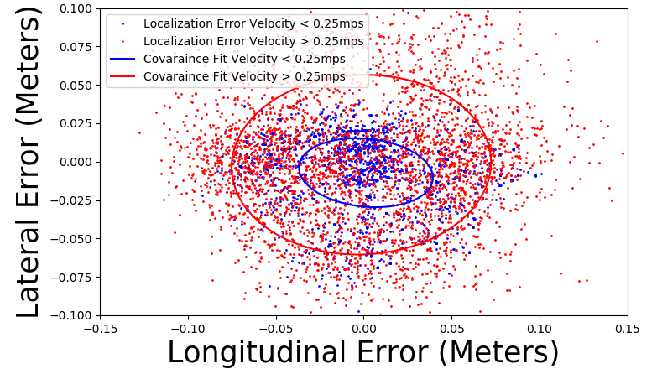
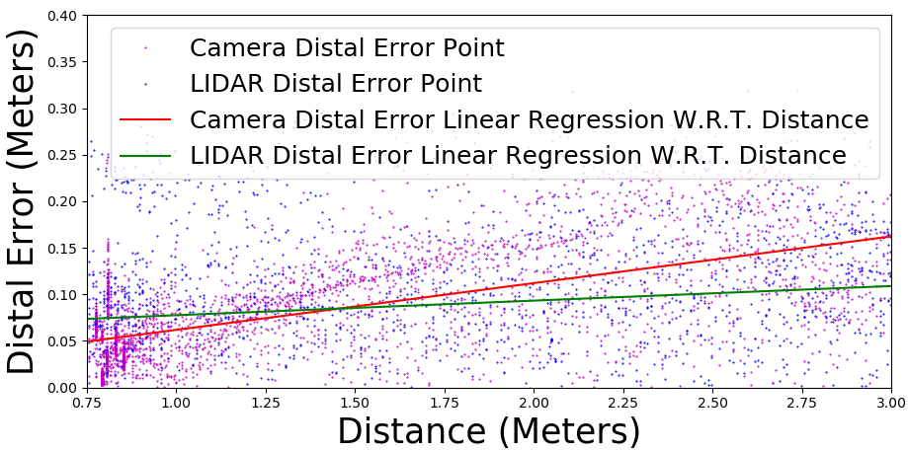
Our Method – Error Classifcation Results
Utilized motion capture system (Optitrack) to log error in each system
Discoveries of interest:
Localization error is heavily dependent on velocity
Camera and LIDAR object detection error are heavily dependent on distance to object
Localization error has an additive effect when converting camera and LIDAR sensing to global coordinates

Slide 10
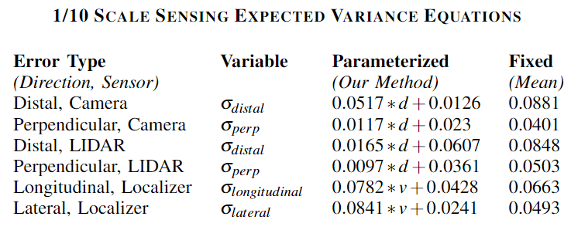
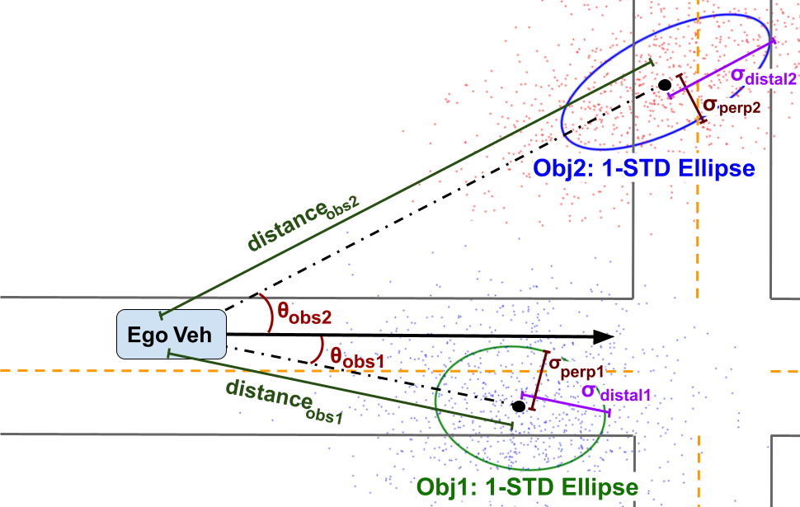
Our Method – Parameterizing Results
We took error classification results and parametrized W.R.T. most significant predictors

Slide 11
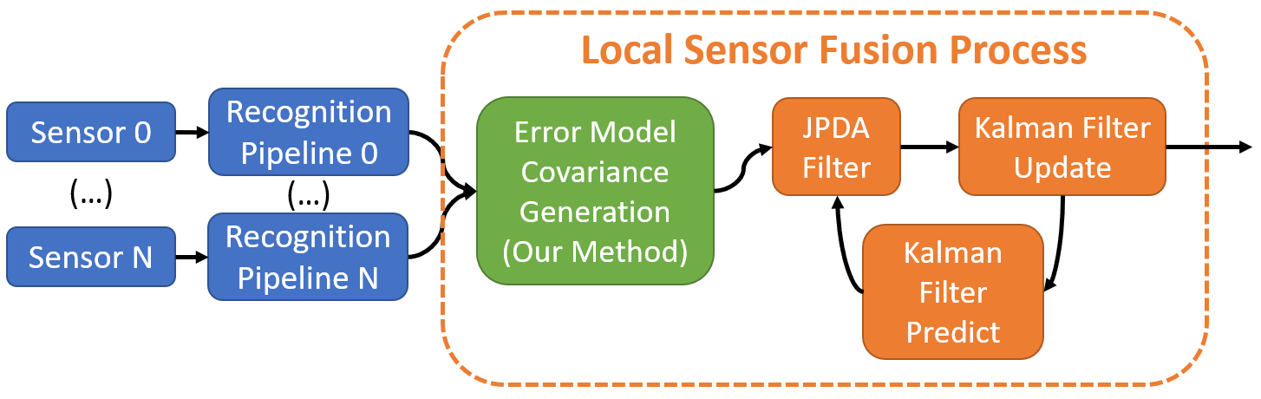
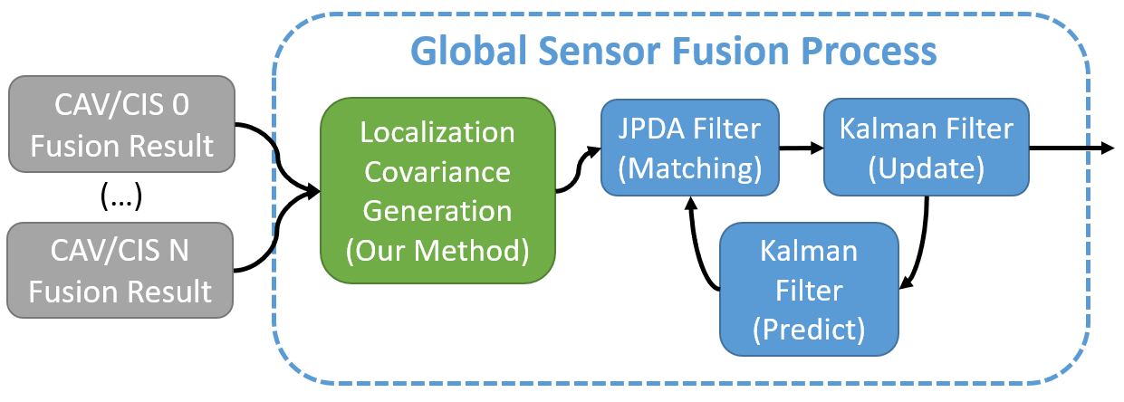
Our Method – Incorporating Into Fusion
Added parameterized covariance estimation step into local and global sensor fusion.

Slide 12
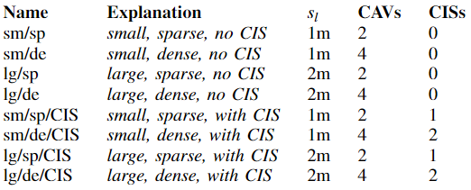
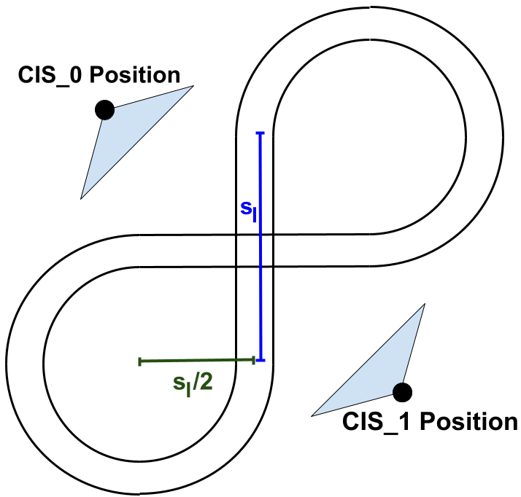
Experimental Setup

Slide 13
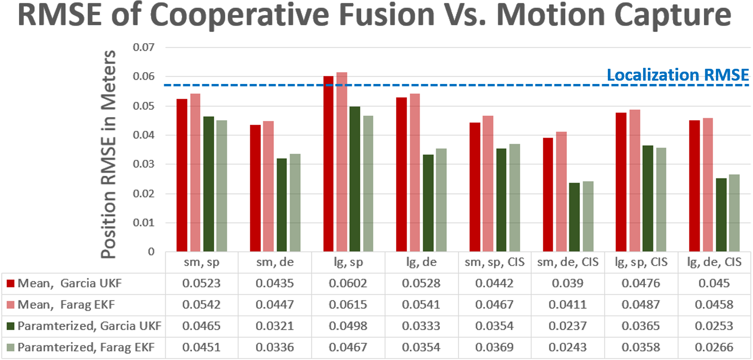
Results

Slide 14

Conclusion
Proper error modeling is essential for accurate cooperative fusion
Localization error is added with sensing error in cooperative fusion and must be modeled
Error can be better estimated using paramterized variance vs. static
1.42x on average and 1.78x in the best case
2x2 Covariance generated on the fly using parameterized terms is useful for many filters (EKF, UKF)
Stationary sensors (CISs) are very valuable due to the lack of localization error
Future work
Expand research to full size connected autonomous vehicles
Look to expand on predictor terms for full size AVs like lighting, weather, city density, etc.

Slide 15
Thank You
Edward Andert and Aviral Shrivastava, ITSC 2022

